Slide 1

MAPING THE UNMAPPED
Presented by:
Nischal Baral
Prashant Manandhar
Samir Wagle

Slide 2

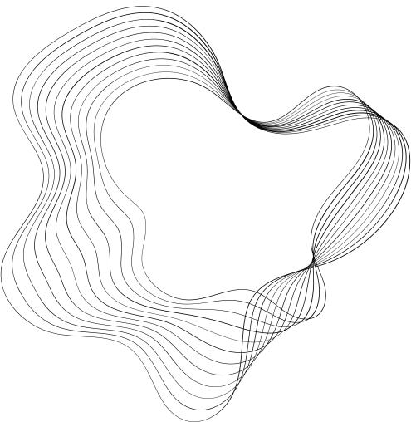
Introduction
Close your eyes and imagine a world where every individual, every place, has a unique digital identifier. Now open them, as we present a solution to turn this vision into a tangible reality.
The digital age has illuminated the disparity in addressing across the globe. Our presentation introduces a geospatial hashing algorithm intends to address this problem based on Nepal's context and geography.

Slide 3

Addressing The Unaddressed
With the increase in urbanization, the need to check the location is a need for different professions
Despite multiple attempts, a reliable and easy way to map the features is a need
With the digitalization of the governance, the need to map each building with a code is a must
We came up with this solution
Ceo Of Ingoude Company

Slide 4





OUR WORK
Provide a conventional way to help locate the mapped location with ease.
Bridges the gap by converting geographical coordinates into unique, easy-to-communicate addresses.
A geospatial hashing algorithm designed to provide concise yet accurate addresses

Slide 5
How Our Hashing Algorithm Works
District Number
Metro, Sub Metro, Municipality, R.Municipality
Nearest Landmark
Algorithm Code
(BASE64 ENCODED )
011
XXX
XXX
XXX
BNP
XXX
XXX
XXX
CHARDOBATO
ad-Bf
Example: 011-BNP-CHARDOBATO-ad-Bf

Slide 6

LETS MOVE TO THE DEMO

